Slide 1


Slide 2
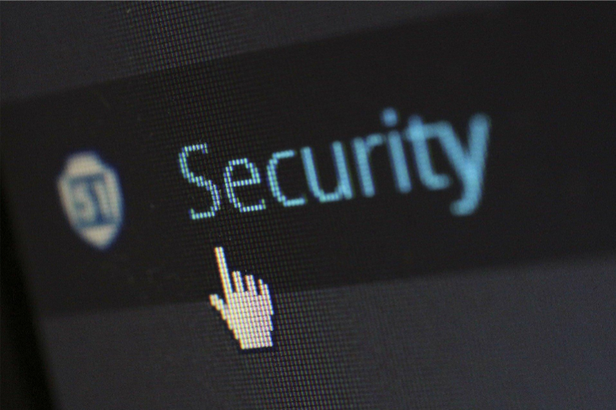
What is hacking? Hacking what?
… the act of identifying any sort of weaknesses within a computer or network’s security system and then using that weakness to gain access to protected information …
May be done for legitimate reasons to locate flaws in a system
May be done to test skills: using a system as a complicated problem or puzzle
Maybe to steal information, financial gain, or to cripple a system

Slide 3
Malware
A program that is inserted into a system, usually covertly, with the intent of compromising the confidentiality, integrity, or availability of the victim’s data, applications, or operating system or of otherwise annoying or disrupting the victim.
Types of Malware
History of Malware
Virus
Trojan horse
Worm
Logic bomb
Time bomb
Micro virus
Spyware
Zombie
Backdoor
1982 Elk Cloner
1988 Morris worm
1989 Ghostballs
1995 Concept
1998 Back Orifice
1999 Melissa
2000 IloveYou
2001 Code Red
2001 Code Red II
2001 Nimda
2003 Slammer worm
2004 MyDoom worm
2004 Bagle worm
2007 Storm worm
2008 Conficker
2010 Stuxnet worm
2011 Duqu
2013 CryptoLocker
2014 Regin
2016 Tiny banker trojan
2017 WannaCry
How do they spread? How to detect and remove them?

Slide 4
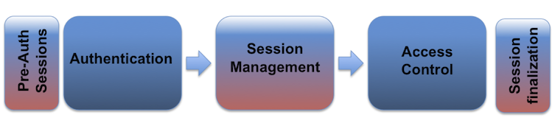
Mitigation
Session Hijacking
Secure networks
Reduces threats
Still can have a valid user performing this attack
VPN to a secure network
Avoid login to web sites without secure sessions
Hijack someone else’s web site session
Vulnerability created by not encrypting the returned session id (cookie)
Additional types of session attacks
Clickjacking
Session fixation

Slide 5
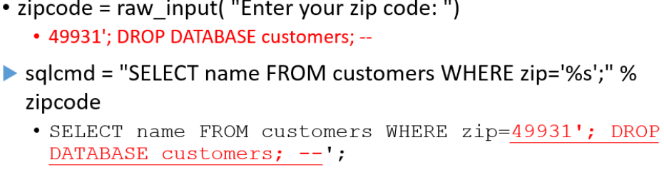
SQL injection
‘inject’ SQL code or commands into user input fields to manipulate a SQL database
The database may output information or possibly add or remove information, if successful …
SQL Basics : Select, command used to retrieve data from a database or table
SELECT * FROM customers WHERE zip = `15902`;
Output might contain information like ID, Name, Address, City, State, Zip
http://bobby-tables.com

Slide 6
Recognizing and reporting phishing emails
30% of small businesses consider phishing to be top cybersecurity concern
stop and think before clicking on a link or attachment in a message and know how to spot the red flags
Reward or free gift message : Free things are enticing, but they can also be dangerous. If you get an email saying you won a free TV or “click here to enter a prize drawing,” be on high alert! Hackers are trying to bait you into clicking a malicious link.
Login or password message : Another type of phishing email asks you to verify your account by logging into a (fake) webpage or updating your credentials. These emails can collect your username and password, giving a hacker instant access to your account.
Urgent message : An urgent phishing email is designed to get you to act fast. It might tell you that your account was hacked or will be deactivated — click here to restore it! Fear makes people do things without thinking, so slow down!
Internal messages : Hackers will try to impersonate people at your company, such as someone in the HR department, IT department or even a coworker. An internal message phishing email might ask you to click on a link to read and sign a policy, read a document about a company-wide update or even hand over sensitive information.
Only 60% of adults could define what “phishing” is. (Google)
Nearly 3 out of 4 companies experienced a phishing attack in 2020 (Symantecs).
72% of respondents reported that they checked to see whether messages were legitimate (i.e., phishing or a scam) compared to 10% who reported not doing so. (NCA)
Nearly half of the participants (48%) reported phishing emails to the sender (e.g., the real person the cyber-criminal tried to impersonate by sending the phishing email). (NCA)
42% of the participants said they used the reporting capability on a platform (e.g., Gmail) “very often” or “always”. (NCA)

Slide 7
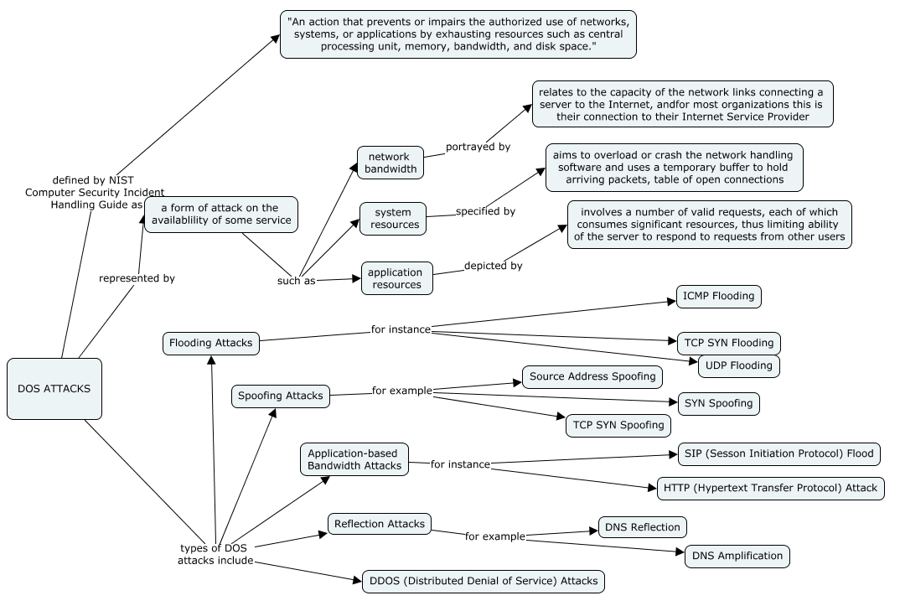
Denial of Service (DOS)

Slide 8
Reasons for Hacking...
Financial Gain: One of the primary motivations for hacking is financial gain. Hackers may attempt to infiltrate systems to steal sensitive information, such as credit card details, bank account information, or personal data. This stolen information can then be sold on the black market or used for fraudulent activities, leading to financial profits for the hackers.
Espionage and Intelligence Gathering: Nation-states, intelligence agencies, or corporate rivals may engage in hacking activities to gather sensitive information for strategic, political, or economic purposes. They may target government organizations, corporations or even individuals to obtain classified data or trade secrets.
Activism and Hacktivism: Some hackers engage in hacking as a means of expressing their political or social beliefs. Hacktivists often target organizations or individuals they perceive as unethical or corrupt. They may deface websites, leak sensitive information, or disrupt services to raise awareness about certain causes or to promote their ideology.
Personal Challenge and Curiosity: Certain individuals are motivated by the technical challenge and intellectual curiosity associated with hacking. They may attempt to break into systems to test their skills, explore the vulnerabilities of computer networks, or push the boundaries of what is possible.
Revenge and Vendettas: In some cases, individuals may resort to hacking as a form of revenge or personal vendetta against someone or an organization they perceive as having wronged them. This can involve unauthorized access to systems, leaking private information, or causing damage to their target's digital infrastructure.
Cyber Warfare and State-Sponsored Attacks: State-sponsored hacking activities are carried out by governments or state-affiliated groups with the aim of disrupting or sabotaging other countries' critical infrastructure, defense systems, or communication networks. Cyber warfare can involve hacking into military systems, power grids, or financial institutions.
"ethical" hackers use their skills to identify vulnerabilities and help organizations improve their security

